Slide 1
The Rehn-Meidner Model in Central Eastern Europe
Dr. Pogátsa Zoltán
Uni of Western Hungary

Slide 2
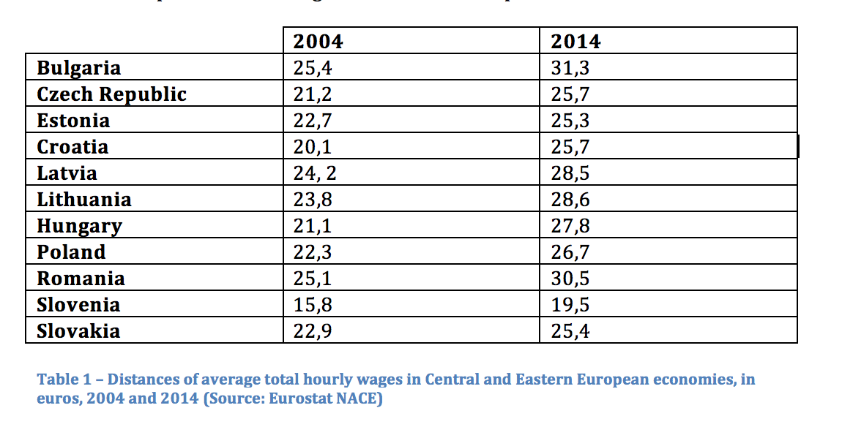
Wages diverging from Northwestern Europe

Slide 3
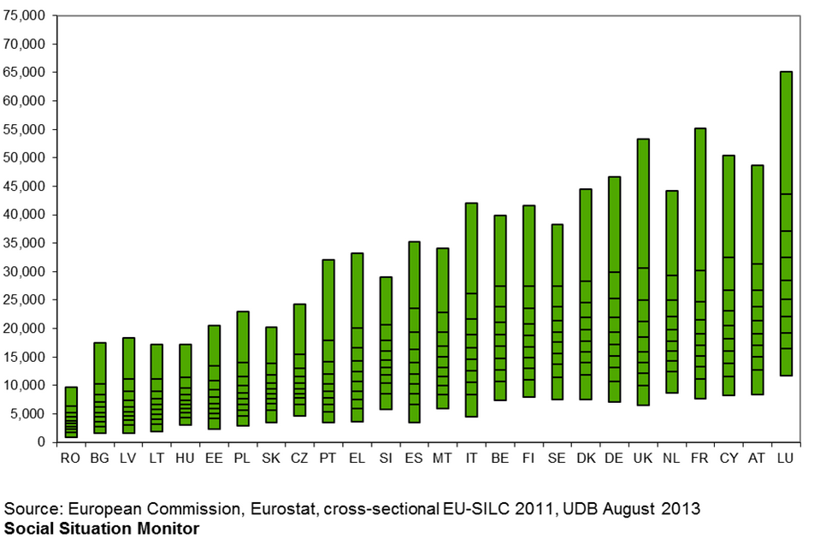
Income levels (PPP)

Slide 4
Disadvantages of low wages
Low standard of living (1.2m earning below living wage in Hu)
Lower employment levels due to low demand
Keynesian growth models (Domar, Kaldor): az lower demand retards the increase in increase in productivity

Slide 5
Determinants of wages:
Step One: the common productivity of the two factors of production determine value added.
Step Two: capital and labour divide value added based on raw social power. There is no meritocratic market based process involved.
(Piero Sraffa 1960)

Slide 6
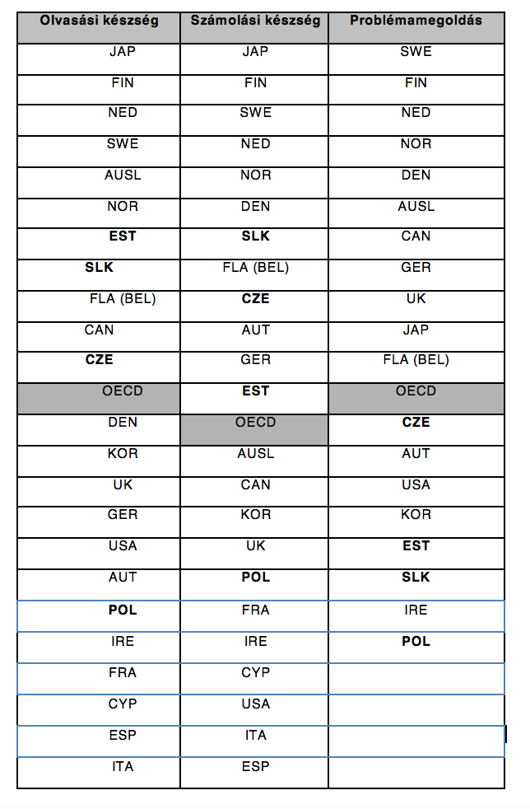
OECD PIACC
Market skills of employed, 2013

Slide 7
Productivity and wages

Slide 8
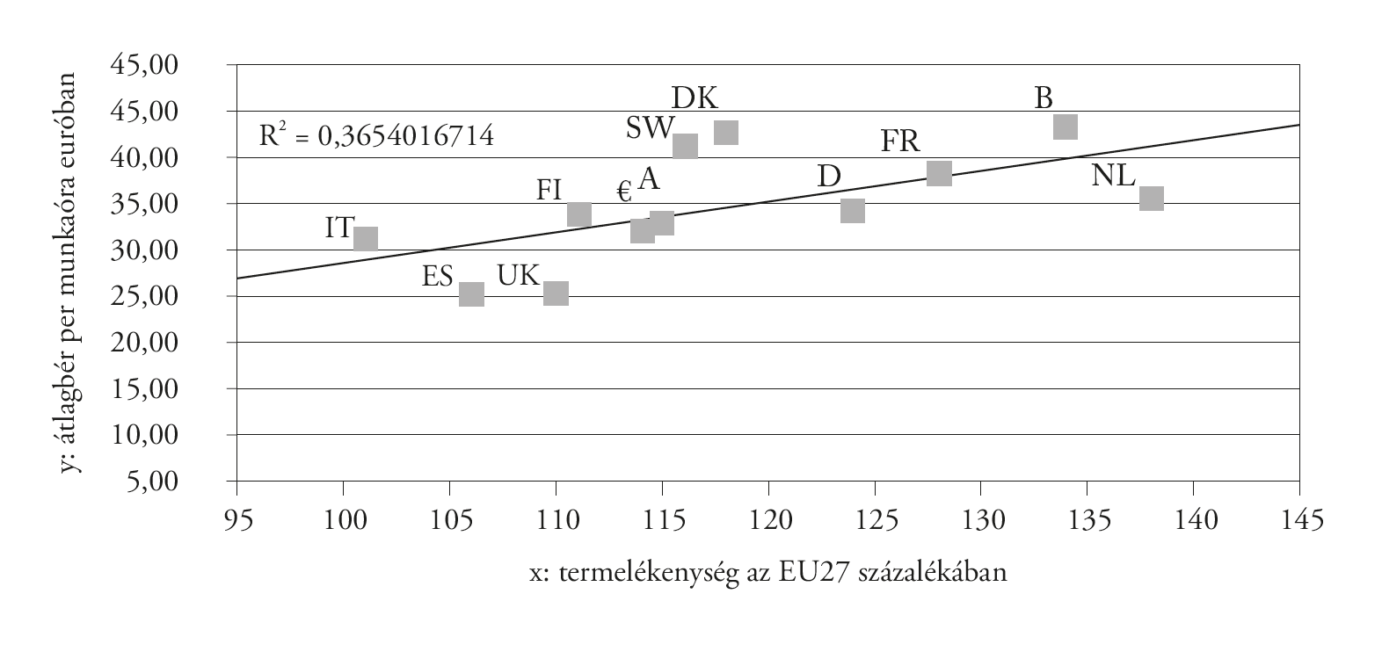
Heteroscedasticity: The same does not hold for Western Europe alone!

Slide 9
What determines average wages?
Minimum wages influence average productivity:
CEE FDI dependent competition state (Nölke and Vliegenhart) minimum wage: €2-3 Below the living wage: social dumping.
Northwestern European minimum wages and wage floors: €8.5-15
CEE pulls low value added on itself

Slide 10
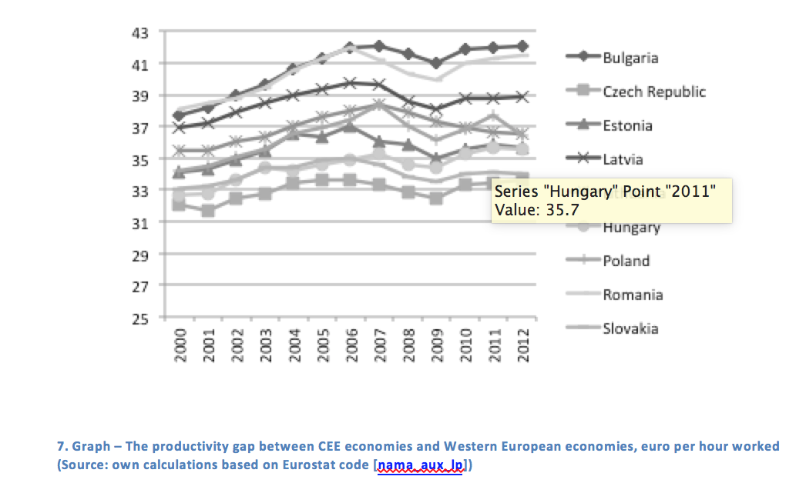
Productivity is also diverging!

Slide 11
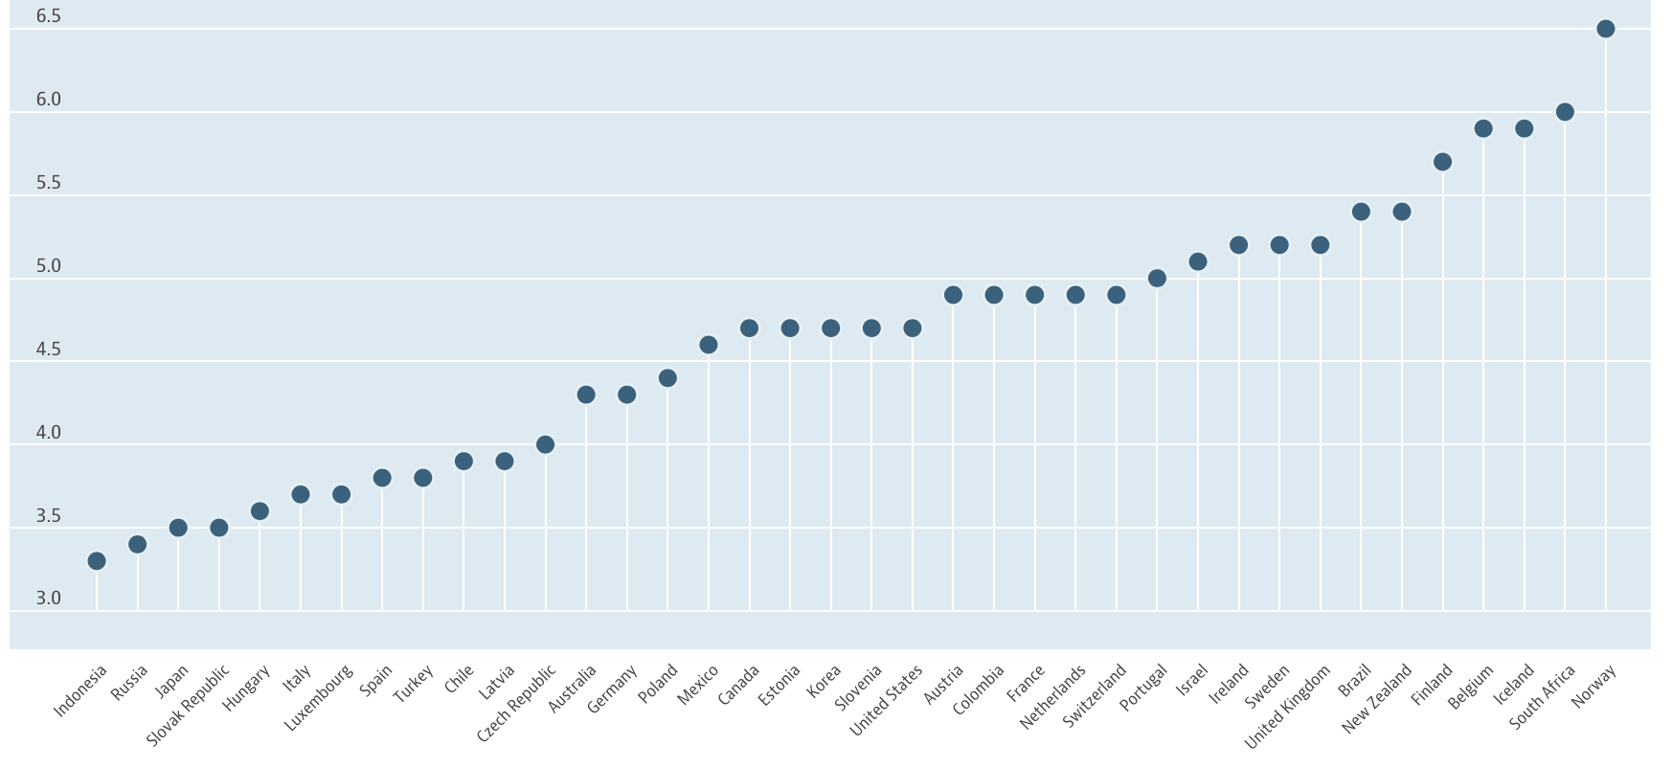
Educational expenditure in CEE (OECD 2012)

Slide 12
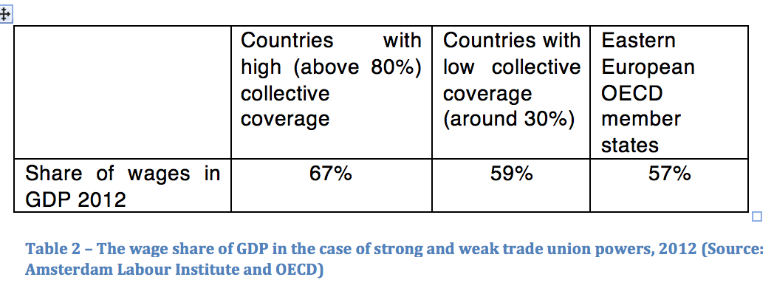
Step Two: The Division of Value Added

Slide 13
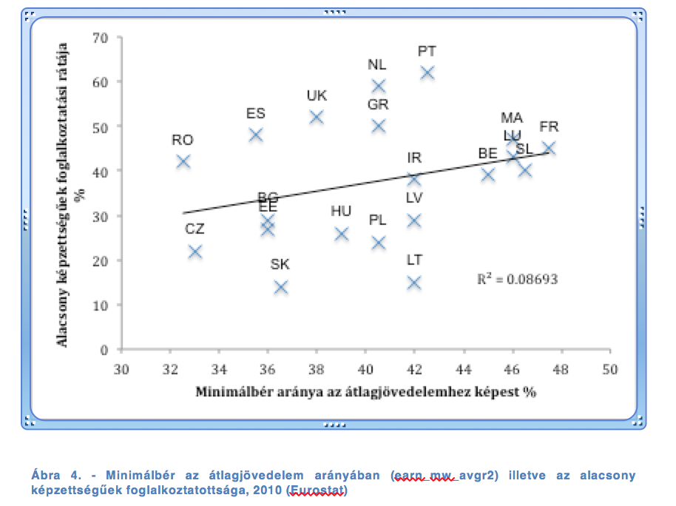
Minimum wage and employment

Slide 14
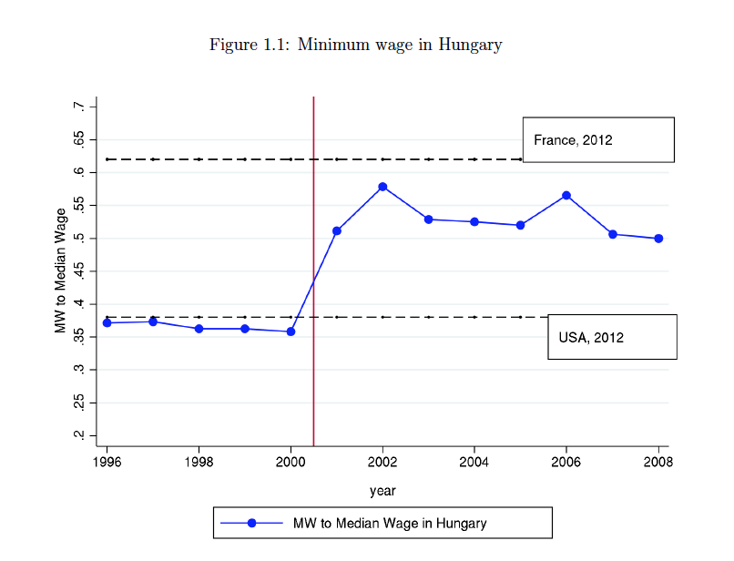
Massive wage increase Hungary 2001-2002
(Lindner 2015)

Slide 15
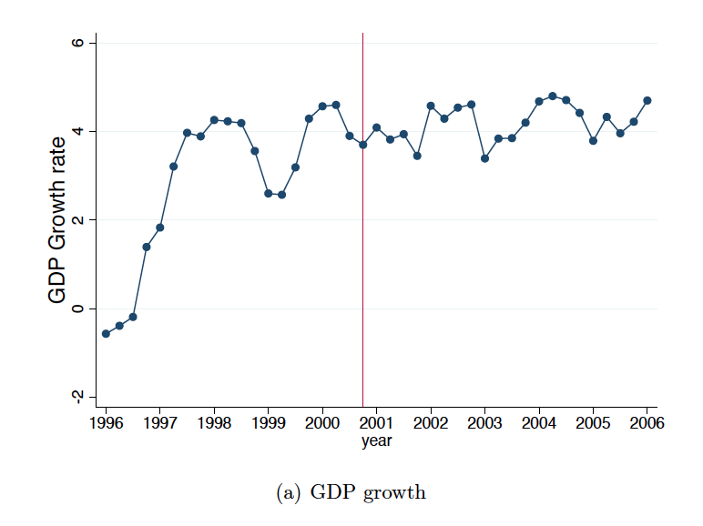
GDP
(Lindner 2015)

Slide 16
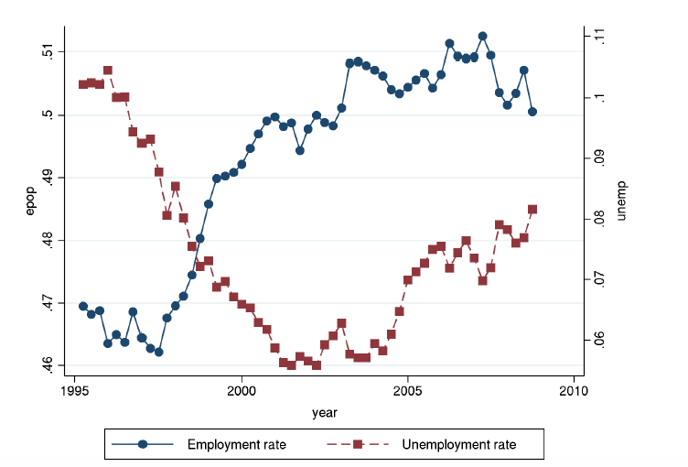
(Lindner 2015)
Employment and Unemployment

Slide 17
Solution
Rehn-Meidner model
Industry wide wage negotiations and wage floors
Ghent model for strong trade unions

Slide 18
Thank you!
pogatsa@gmail.com

